Slide 1
AGENDA
ASEAN eBanking market
What we have & Benchmarking
Viet Nam eBanking market
Some food for thought
IT Proposal
Digital Technology: Seven strategic areas to consider
Appendix

Slide 2
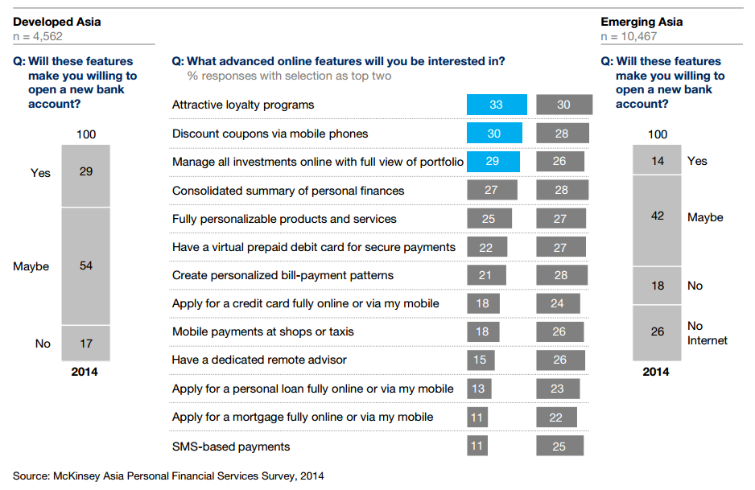
ASEAN eBanking market What do consumers really want?

Slide 3
Viet Nam Mobile Application Benchmarking #1
Features | FE Credit | Sacombank | ACB | HSBC | CitiBank
Downloads (Android only) | ~10K | ~50K | ~10K | ~1 Mil | ~10K
Languages | Vietnamese English* | Vietnamese English | Vietnamese English | Localization (Multiple languages) | Vietnamese English
Account Management
Current Accounts | N/A |  |  |  | 
Deposit Accounts | N/A |  |  | N/A | N/A
Loan Accounts |  |  |  | N/A | N/A
Credit Cards | N/A |  |  |  | 
Credit Card Information
Card Information | N/A |  |  |  | 
Statement | N/A |  |  |  | 
Transaction History | N/A |  |  |  | 

Slide 4
Viet Nam Mobile Application Benchmarking #2
Features | FE Credit | Sacombank | ACB | HSBC | CitiBank
Fund Transfer by Credit Cards
Fund Transfer | N/A |  | N/A | N/A | N/A
Inter Bank Transfer (iBFT) | N/A | N/A | N/A | N/A | N/A
P2P Money Transfer | N/A |  | N/A | N/A | N/A
Cash on Mobile | N/A |  | N/A | N/A | N/A
Buy Virtual Prepaid | N/A |  | N/A | N/A | N/A
Scheduled Transaction | N/A |  | N/A | N/A | N/A
Bill Payment by Credit Cards
Bill Payments | N/A |  | N/A | N/A | N/A
Mobile Topup | N/A |  | N/A | N/A | N/A
Prepaid Card Topup | N/A |  | N/A | N/A | N/A
Scheduled Transaction | N/A |  | N/A | N/A | N/A

Slide 5
Viet Nam Mobile Application Benchmarking #3
Features | FE Credit | Sacombank | ACB | HSBC | CitiBank
Service Request
Open Account | N/A |  | N/A | N/A | N/A
Card Activation | N/A | N/A | N/A | N/A | 
Card De-activation | N/A | N/A | N/A | N/A | 
Products & Services
Location (ATM, Branches, POS…) |  |  |  |  | 
Products & Services |  |  |  |  | 
Promotion |  |  |  |  | 
About Us/Tips/Fx Rates |  |  |  |  | 
Message box |  | N/A | N/A | N/A | N/A

Slide 6
ASEAN eBanking market – Segregating Leaders and Laggars
No | Bank | Downloads | OS | Vendor | Framework
1 | Citibank | ~5,000,000 | Android, iOS, Windows Phone | Self Development | IBM MobileFirst
2 | DBS | ~1,000,000 | Android, iOS, Windows Phone | Tagit (Mobeix)/ Infosys | IBM MobileFirst
3 | UOB | ~500,000 | Android, iOS, Windows Phone | Tagit (Mobeix) | IBM MobileFirst
4 | OCBC | ~500,000 | Android, iOS, Windows Phone | Tagit (Mobeix) | IBM MobileFirst
5 | Maybank | ~1,000,000 | Android, iOS, Windows Phone | Tagit (Mobeix) | IBM MobileFirst
6 | Bank Central Asia | ~1,000,000 | Android, iOS, Windows Phone | SiteCore
7 | Sacombank | ~100,000 | Android, iOS | Infosys/ Self Development
8 | Kasikorn Bank | ~5,000,000 | Android, iOS, Windows Phone | N/A
9 | CIMB Group | ~1,000,000 | Android, iOS, Windows Phone | N/A
10 | Bank of Ayudhyda | ~1,000,000 | Android, iOS, Windows Phone | N/A
# | AXIS Bank | ~5,000,000 | Android, iOS, Windows Phone | Tagit (Mobeix) | IBM MobileFirst
# | ICIC Bank | ~10,000,000 | Android, iOS, Windows Phone | Infosys
Note: This ranking is based on mobile application features that provided to customers

Slide 7
AGENDA
ASEAN eBanking market
What we have & Benchmarking
Viet Nam eBanking market
Some food for thought
IT Proposal
Digital Technology: Seven strategic areas to consider
Appendix

Slide 8


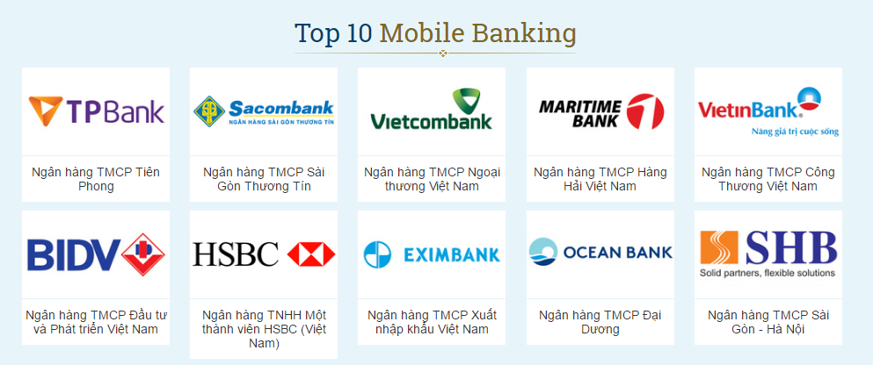
Viet Nam eBanking market

Slide 9
Viet Nam eBanking market
No | Bank | Downloads | OS | Vendor | Framework
1 | Sacombank | ~50,000 | Android, iOS | Infosys/ Self Development
2 | TPBank | ~50,000 | Android, iOS | Tagit (Mobeix)/ FPT Software | IBM MobileFirst
3 | Vietcombank | ~500,000 | Android, iOS | VNSWITCH
4 | Eximbank | ~500,000 | Android, iOS | Infosys
5 | PVCom Bank | ~1,000,000 | Android, iOS | Misys | Fusion Banking
6 | ACB | ~10,000 | Android, iOS | CMC | IBM MobileFirst

Slide 10
IT Proposal. Roadmap – Project Scope – Phase 2
Existing Scope
App rating & review
Loan offer checking
Multiple addresses & Phone contact
Proposed Scope
App rating & review
Display offer & reward
Loan offer checking
Display offer & reward
Survey (loan, customer satisfaction)
Geolocation & customer activity tracking
Credit card services integration(Part 1)
Survey (loan, customer satisfaction)
Geolocation & customer activity tracking
Page 10

Slide 11
IT Proposal. Phase 2 – Key features
Marketing & Sales | Customer on boarding & Account Opening | Services
Hand-over (2 months)
Phase 2(X ~ MM.DD.YY + Q1)
Customer Education (App rating/review) | Card Services Integration (Part 1) | Card Online Transaction Processing Mobile Top-up
Geolocation/Activities Tracking | Request Status Check (Loan/Payment/Service Request) | Loan/Credit Card Payment
Member get Member (Offer & Reward) | Trusting Socials | PIN/OTP Authentication
Red: Replaced/new features
Blue: Quick win
Page 11

Slide 12
IT Proposal. Roadmap – Project Scope – Phase 3
Existing Scope
Check MRC Status
In-app image processing (document upload)
Connect with Bluetooth printer
Proposed Scope
Credit card integration (Part 2) - Loan/credit card disbursement (cardless, iBFT)
P2P Fund transfer (Master Card QR Pass, e-wallet integration)
Financial management (tips, management tools)
Display special product on app
Paid for instalment by credit cards
Bill Payment (electricity, water, telco, mobile…)
Partnership integration (Sacombank, Payoo, NAPAS, Moven…)
Paid for instalment by credit cards
Bill Payment (electricity, water, telco, mobile…)
Application (loan/credit card) status checking
Application (loan/credit card) status checking
Page 12

Slide 13
IT Proposal. Roadmap
Loan/Credit Card Payment
Money Transfer
Beacon
Bill Payment
2016
Hand-over(2 months)
2017
Card online transaction processing (NAPAS, Sacombank...)
(X – MM.DD.YY + Q1)
Loan disbursement - Cash on mobile
(X – MM.DD.YY + Q1)
Cooperation with bill payment service provider (Payoo, VNPAY)
(X – MM.DD.YY + Q2)
Cooperation with partners in money transfer (MOMO, Sacombank, VIMO...)
(X – MM.DD.YY + Q2)
Research on beacon technology
(X – MM.DD.YY +
Q2)
Page 13

Slide 14
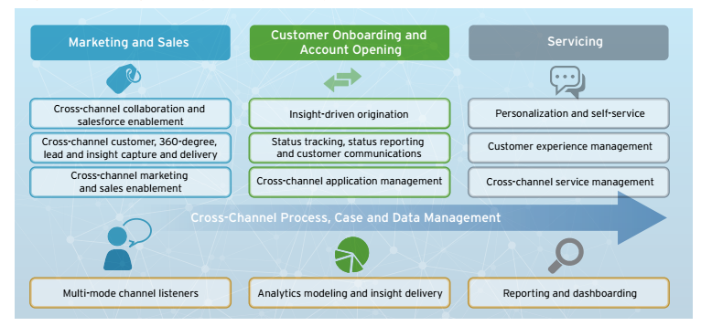
Digital Banking Enterprise Roadmap
Source: Cognizant
We have it
In-progress
We need to develop it

Slide 15

Page 15

Slide 16
Appendix

Slide 17
Roadmap. Planned features #1
Part 1(Phase 2)
Product Name
Card Status
Card Credit Limit
Part 2(Phase 3)
Credit Card Activation
Insurance (De)Activation
Block/Un-block Card
Card Number (masked card)
Open to Buy Balance
Total Outstanding Balance
Minimum Due Amount
Payment Due Date
Supplementary Card Request
Card Replacement Request
Master Card QR Pass
Cash withdraw (cardless)
Credit Card Information
Service Request

Slide 18
Roadmap. Planned features #2
Credit Card Payment
Bill Payment/Mobile Top-up
P2P Money Transfer
Today
Transactions
Current
Statement
Master Card
QR PASS
Past
Statement

Slide 19
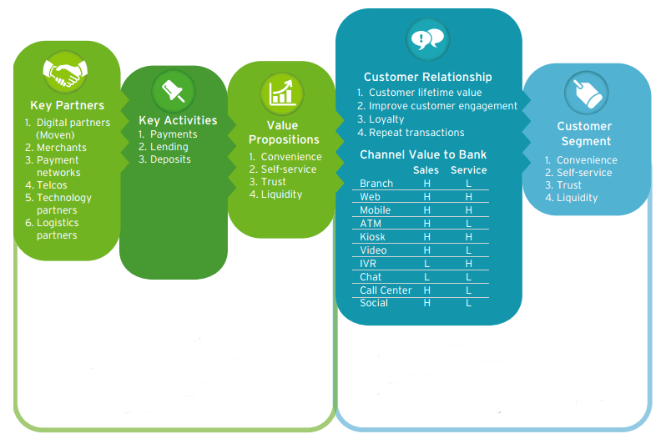
Digital Banking’s Multi-dimensional Attributes
Source: Cognizant

Slide 20
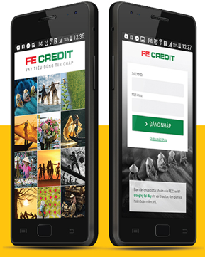
FECREDIT Application Features Goals.
MOBILE
Online Payments
Push message & message box
POSs and Recollection Branches
Customer Profile (Wish-list, Hobbies)
Production info, Tips, FAQ, Hotline
Loan calculator
Apply now
Loan & Credit Card
3rd party Integration
Tracking customer activity and behavior
Promotion and reward
Focus on improved UX
Offline mode

Slide 21
Digital Banking Software Vendors

Slide 23
How payment processing work
Source: www.cybersource.com

Slide 24
How payment processing work
Step 1: Purchaser places order.
Step 2: Merchant securely transfers order information to CYBS over the Internet. CYBS receives order information and performs requested services.
Step 3: CYBS formats the transaction detail appropriately and securely routes the transaction authorization request through its payment gateway to the processor.
Step 4: The transaction is then routed to the issuing bank (purchaser's bank) to request transaction authorization.
Step 5: The transaction is authorized or declined by the issuing bank or card (Discover, American Express).
Step 6: CYBS returns the message to the merchant.
Step 7: Issuing bank approves transfer of money to acquiring bank
Step 8: The acquiring bank credits the merchant's account

Slide 25
How digital wallet work
Source: paypal.com

